Slide 1
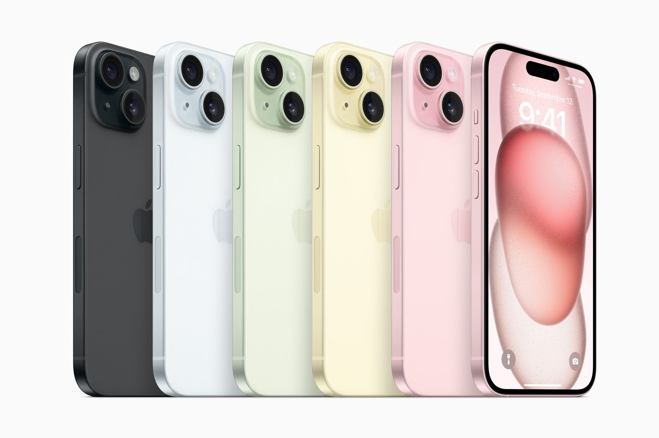

Apple
How important is innovation and enterprise to today’s businesses?
By Harvita, Maison and Yaroslav

Slide 2


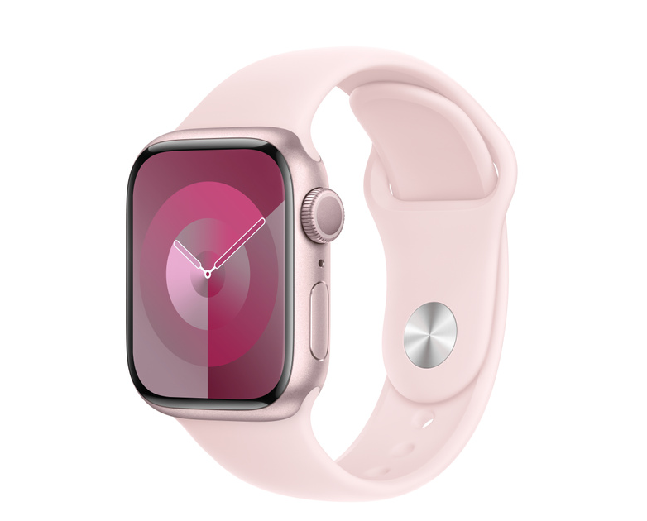

Apple Introduction H
Notes:
Apple Inc., a Silicon Valley-based technology company, produces internet services, software, and consumer gadgets like Apple TV+, iTunes, iCloud, Apple Music, and Apple Watch, with operating systems like iOS and macOS. Apple Computer Company was founded in 1976 by Steve Wozniak and Steve Jobs. The company produced Apple I and Apple II, the first microcomputers with a graphical user interface. However, power disputes and high product costs led to Jobs leaving Apple in 1985. Jobs departed Apple in that year to found NeXT, Inc., while Wozniak withdrew to focus on other projects. The 1990s saw a growth and change in the personal computer market, with Apple losing ground to the more affordable Wintel

Slide 3
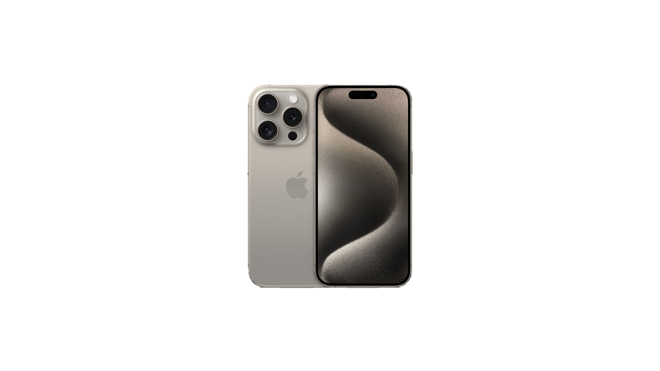
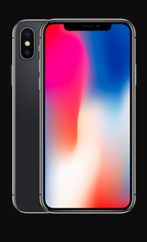
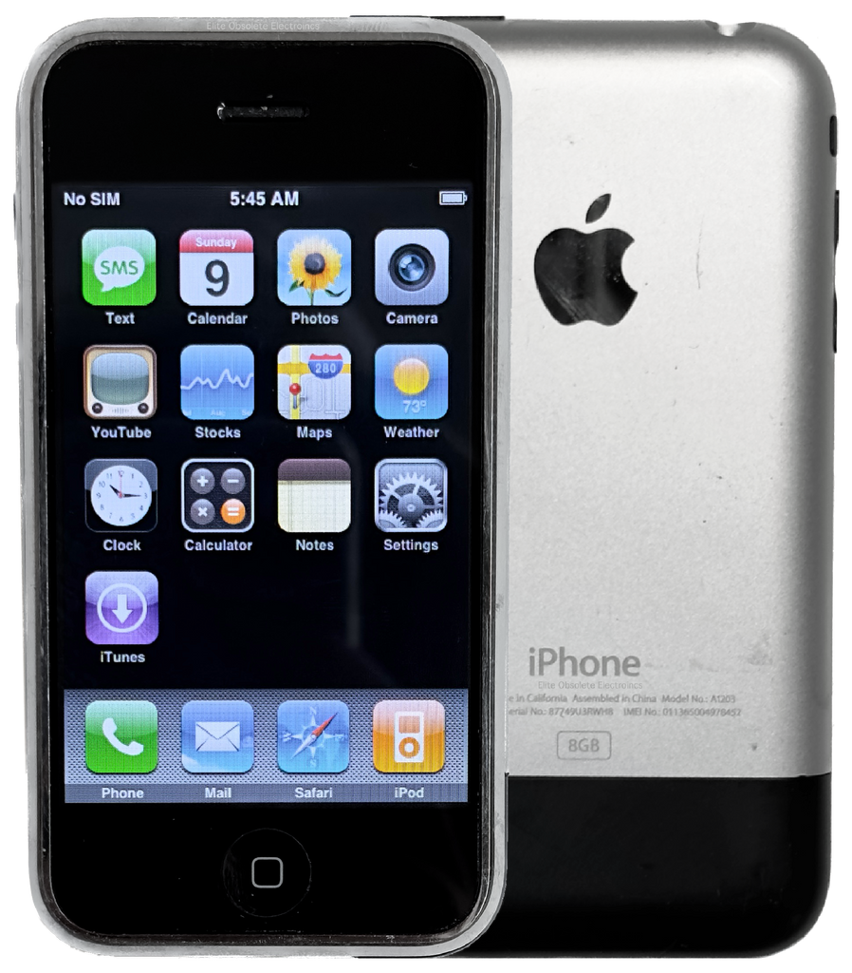
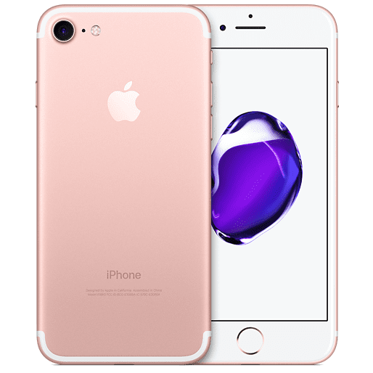
Role of innovation- M
IPhone 7 (6th Generation) (2016)
IPhone X (10th generation) (2017)
IPhone 14 Pro Max (14th generation) (2023)
IPhone 1st Generation (2007)
Notes:
The role of the innovation in terms of Apple is a very important aspect as their whole business model is based off Innovation.
For Example the first IPhone was revolutionary as it was the first Touchscreen Smartphone and came out in 2007 which was a time where this seemed impossible. Where as most phones at the included a physical keyboard whereas the IPhone included a keyboard built into the software
It was also the first multi-touch phone on the market It was the also the first phone to introduce a Home button which shows that even at beginning Apple was innovating beyond anything that any other Phone manufacturer at the time could comprehend at the time.
IPhone 7: When they released the IPhone 7 Apple had a turn of events as they decided to create one of the most powerful chips in a Phone at the time which was revolutionary at the time Also Apple had started innovating their own battery's which was one of the main aspects of the IPhone 7 which was the revolutionary battery life compared to any other phone on the market and was certainly a Massive Upgrade compared to the previous IPhone's It also had no problems rendering some of the most hardware demanding games at the time A controversal innovative idea that Apple had at the time was the removal of the headphone jack on the IPhone 7 which annoyed many people who bought the phone at the time but Apple used this strategy to promote their new product Airpods at the time which allowed them to make double the revenue as they had technically created a problem no one had before and then created a solution to the problem they had created
IPhone X: This was one of the most revolutionary IPhone's as it was the first phone that was fully touchscreen and almost beselless
Iphone 14 pro max: dynamic island

Slide 4

Different ways of innovating Y
Notes:
Different ways of Innovating:
An example of ways that Apple could innovate by developing a unified health ecosystem that seamlessly integrates its devices, or even AI-driven health analytics, and personalised wellness recommendations, thereby enhancing employee well-being and reducing healthcare costs, which in turn would increase business productivity through improved employee performance and reduce absenteeism.
Another good example of exploiting new idea is, Apple could innovate by creating a modular, upgradable hardware platform for its easy devices, allowing customers to easily update individual components like processors, memory, and cameras, which would extend the product lifecycle and reduce electronic waste.
Another potential that Apple has is to drive innovation through the creation of a sophisticated AI-driven virtual assistant, that can potentially smoothly operate on all Apple devices. This would lead to improved task organization, enhanced communication, and automated process, without hiring specialists, ultimately boosting business productivity and efficiency.

Slide 5
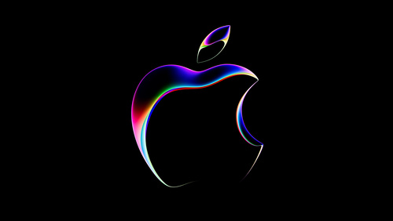
Creative process + Product and service development M
Notes:
Creative Process:
Apple Inc.'s creative process is guided by visionary leadership and a collaborative, user-centered approach. Apple refines products through design thinking, quick prototyping, and iterative feedback, with an emphasis on simplicity and attention to detail. Its secretive culture and integration of hardware and software promote innovation, resulting in high-quality, ground-breaking products that establish industry standards.
Product and service development:
Product and service development is a highly organised process that prioritises innovation, user experience, and seamless integration. It entails multidisciplinary cooperation, quick prototyping, and iterative refining based on user input. Apple guarantees that its products are coherent and optimised by regulating both hardware and software. This strategy, fueled by a culture of secrecy and daring decision-making, regularly produces high-quality, industry-leading products and services that establish new technological benchmarks.

Slide 6

New ways of increasing business efficiency +Successfully exploiting a new idea Y
Notes:
Increasing business efficiency:
Apple can possibly increase its business efficiency by learning artificial intelligent and its machine learning, to streamline its supply chain operations, By implementing AI-driven predictive analytics, Apple can anticipate demand more accurately, reducing overproduction and minimizing inventory costs. Additionally, AI can optimize logistics by selecting the most efficient shipping routes and methods, cutting down on transportation expenses and delivery times. These improvements not only lower operational costs but also enhance the overall customer experience by ensuring faster delivery and better product availability, without needing hiring thousands of workers for less efficient results.
Successfully exploiting new idea:
To successfully exploit a new idea, Apple could delve deeper into the healthcare technology sector by developingadvanced werable devices with itegrated health monitoring capabilities. By partnering with healthcare providers and leveraging the vast data colleted from users, Apple can offer personalized health insights and proactive wellness solutions. This move wuld not only diversify Apple's product line but also create a new revenue stream through health-related services and subscriptions. Integrating these devices with existing Apple ecosystems would encourage user retention and increase the overall value proposition of Appe's products and services.

Slide 7

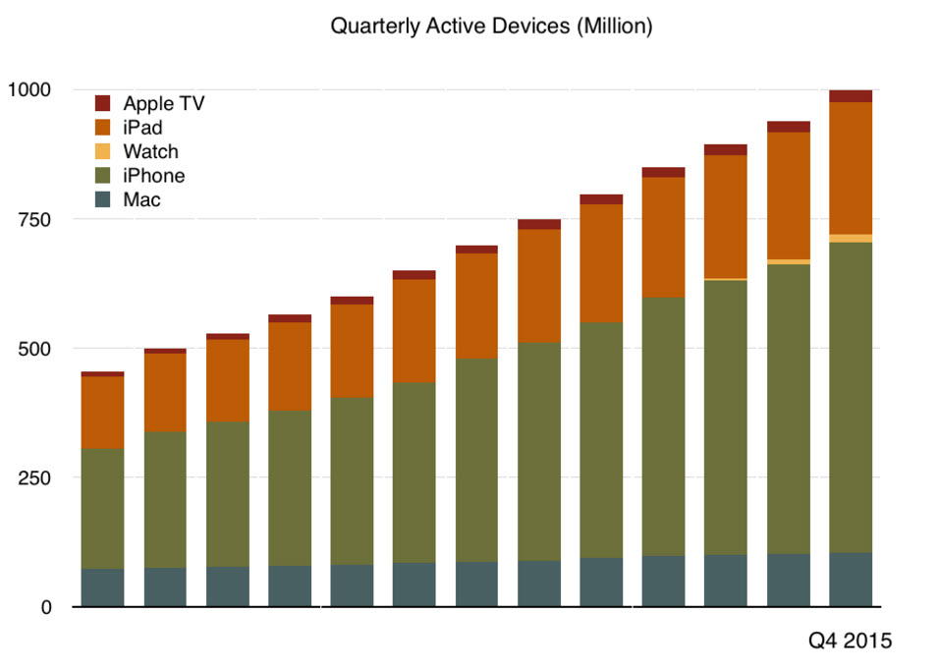
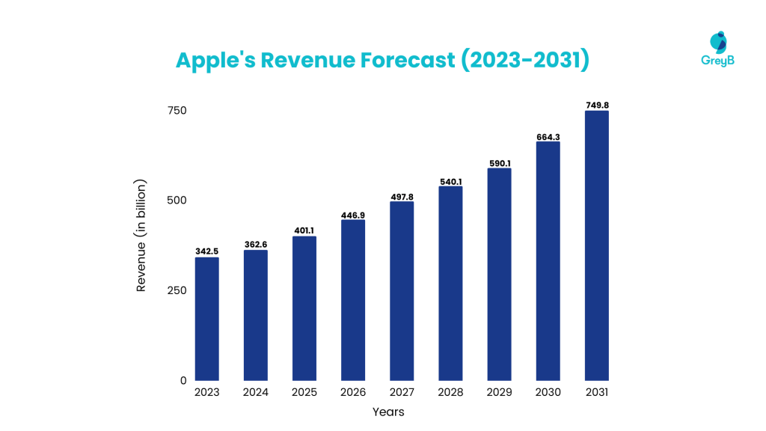
Adding value + Adding services and exploiting new markets H
Notes:
Adding value is very important because it helps companies attract new customers and make their existing customers return and buy the latest version or interest them in a different product that would benefit them. Although it shows their customers that it is a new product it also shows them that there is a new experience and something different has happened to the company that they can be recognised for. Apple has done this by its unique selling points including focus, design and user experience.
Service or markets to differentiate the business from markets; Another way to generate innovation is to differentiate a product or service. This lets a business stand out from the different ways they have developed their brand through their product or a wholly original approach to providing their service. For instance, if you were to compare the Galaxy S24 with the iPhone 15, you would get to the conclusion that the only significant difference is style.

Slide 8

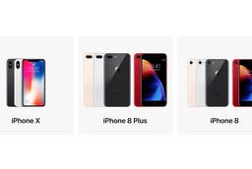

Chance and serendipity H
Notes:
Chance and serendipity are unexpected events that can lead to significant achievements, such as the development of penicillin and the invention of Nutrasweet. Alan Turing's team's work saved thousands of lives and led to the production of the world's first electronic computer. Other examples include Kelloggs corn flakes and the discovery of penicillin later on. One way that Apple has shown serendipity is through their iPhone. Steve Jobs understood that serendipity was the pathway to creativity and innovation. For example, before the iPhone was release it was unheard of to have a music library on a mobile phone. Steve Jobs recognised that the secret to creativity was chance. That's the reason he never established distinct divisions for engineers and designers. He desired for them to be interacting and exchanging ideas all the time.

Slide 9
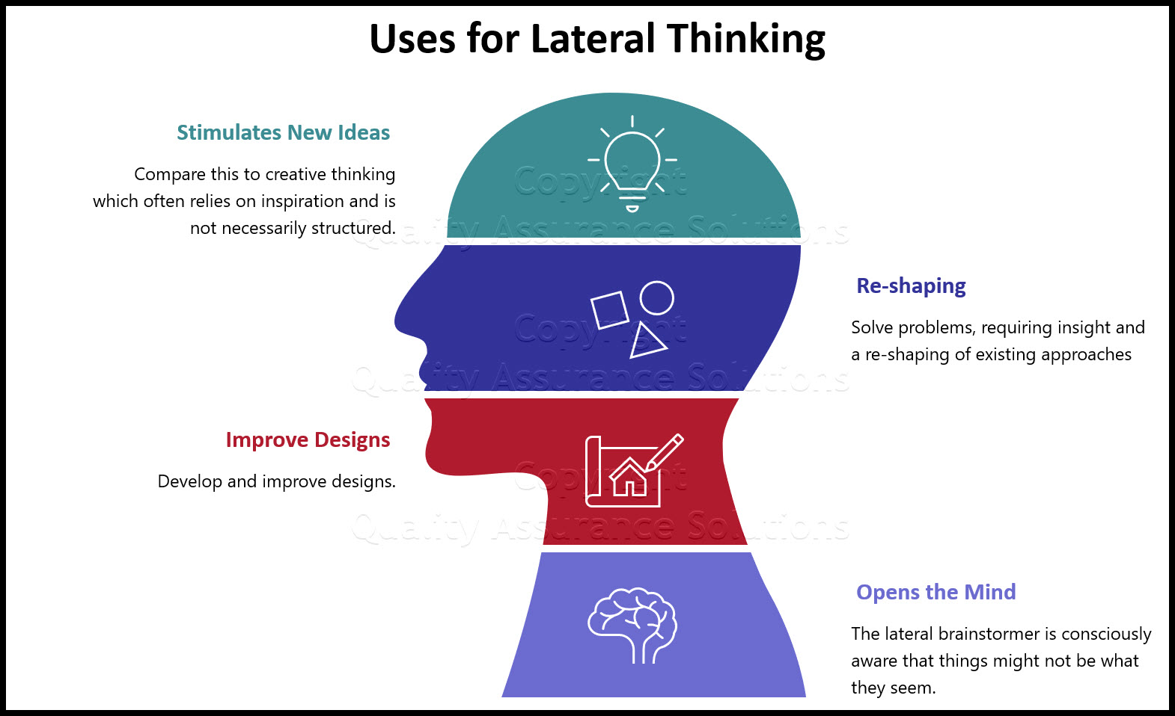
Lateral thinking and intuition M
Notes:
Lateral Thinking:
Apple Inc. employs lateral thinking to drive innovation and solve problems creatively. By encouraging out-of-the-box thinking and challenging conventional norms, Apple discovers unique ideas and designs, exemplified by products like the iPhone and iPad. This approach, combined with cross-functional collaboration, allows Apple to continuously set new industry standards.
Intution:
Apple Inc. uses intuition to make decisions, relying on the instinctual insights of its seasoned leaders and designers. This method enables the organisation to anticipate user demands and market trends, resulting in unique goods that resonate well with customers. Intuitive judgements at Apple frequently result in bold, industry-defining decisions that prioritise user experience and simplicity.

Slide 10

Blue sky thinking + Creativity Y
Notes:
Blue sky thinking:
Apple has become incredibly famous, and personally Steve Jobs made Apple revolutionary for his critical blue sky thinking. As He was the first person who introduced to the world, the first sensor phone that had radically changed whole smart device industry. During Steve Job’s era, Apple exemplified blue sky thinking by relentlessly pursuing innovation without constraints, leading to groundbreaking products that transformed entire industries. Jobs fostered a culture of creativity and risk-taking, encouraging his team to think beyond traditional boundaries. This mindset resulted in revolutionary products such as the iPod, which redefined music consumption: The iPhone, which combined communication, entertainment, and computing in an unprecedented way and the iPad, which created a new category of portable computing, Jobs’ vision of seamless integration of hardware and software, coupled with an uncompromising focus on design and user experience, allowed Apple to conceive and execute ideas that seemed impossible at the time, solidifying its reputation as a leader in technological innovation.
Creativity:
Apple has become one of the most creative company in human history. Steve Jobs was known for his memorable proving points. In one of the press conference, he dropped a prototype of iPod in water, by explaining that there are lots of bubbles coming out, which is the reason of unused space inside of iPod, which he considered as a huge problem. Steve Jobs has made devices such as: Apple II, Macintosh, iPod, iPhone, iPad, and first Apple Stores during 1971-2011.
Current Apple environment is lacking individuality, it is still standing on world market, as a head leader, however, it does not have that innovative thinking and creativity, that was a priority for Apple, during Steve Jobs era.

Slide 11
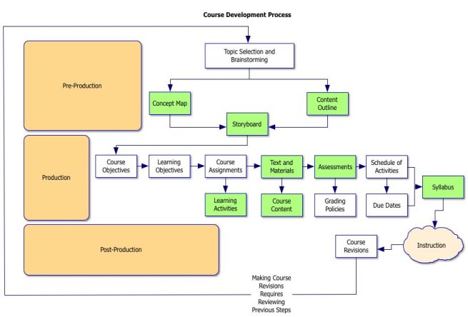

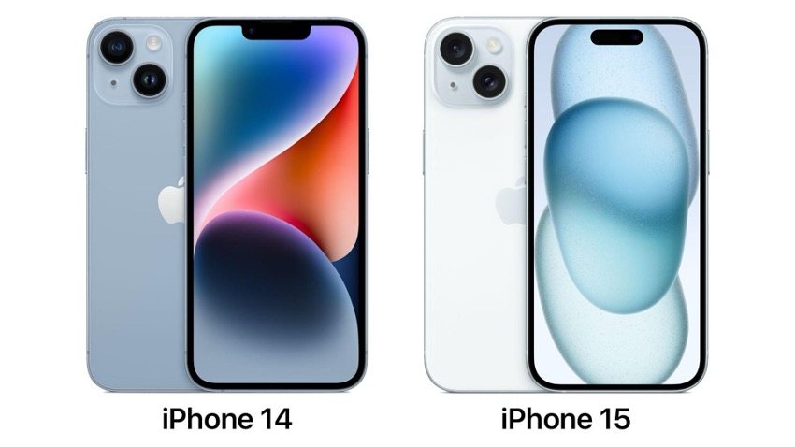
Improvements to products +Processes +Services and customer experience H
Notes:
There will be enough advancements made to current items to raise earnings in the end by lowering production costs or raising prices. If these upgrades are indeed required, there is a need for them. It wouldn't be sensible, for instance, to stop producing combo microwave ovens and disregard the need for simple models, or to think that people no longer need cell phones with built-in cameras.
Procedures may be too laborious or complex to be effective, and you may be able to recall an instance in which a process obstructed something. In the public sector, too bureaucratic procedures are frequently blamed for work duplication or delayed outcomes.
Offerings and client encounters Services and the client experience can be substantially enhanced by innovation and enterprise. For instance, advancements that will result in less excruciating dental care could completely transform the experience of patients. Similarly, travellers may arrive feeling considerably more rested following flights when Virgin Atlantic initially added flat beds to their business class cabins in 1998.

Slide 12

Business growth + developemt of new and niche markets +offering ups Y
Notes:
Business growth:
Apple's business growth has been driven by a combination of innovative product development, strategic market expansion, and strong brand loyalty. The company continually sets industry standards with groundbreaking products such as the iPhone, iPad, and Mac, which have revolutionized personal technology. Apple's expansion into services, including the App Store, Apple Music, and iCloud, has diversified its revenue streams and increased customer retention. Global market penetration, particularly in emerging economies, has further bolstered its sales. Coupled with a robust ecosystem that integrates hardware, software, and services seamlessly, Apple's ability to maintain premium pricing and high profit margins has consistently propelled its financial success and market valuation.
Development of new and niche markets:
Apple's development of new and niche markets has been marked by its strategic entry into wearable technology, home automation, and digital health. The launch of the Apple Watch exemplified its successful penetration into the wearable market, offering health and fitness tracking features that have positioned it as a leader in digital health. With products like HomePod and the HomeKit framework, Apple has ventured into the smart home market, aiming to create an interconnected ecosystem of devices. Additionally, the introduction of services like Apple Arcade and Apple TV+ highlights its expansion into digital entertainment, targeting niche audiences with exclusive content. By continually innovating and entering these specialized markets, Apple has not only diversified its product portfolio but also strengthened its ecosystem, ensuring sustained growth and consumer engagement.

Slide 13

Improved recognition and reputation + branding + smarter working M
Notes:
Improved recognition and reputation+ Branding:
Apple Inc. uses its high brand awareness and reputation to propel commercial growth. Apple's reputation for quality and innovation has earned them a dedicated consumer base and premium pricing. This established reputation allows for favourable supplier terms, strategic collaborations, and successful marketing, resulting in widespread attention and strong sales for new product releases. They also have grown a massive following and it is a fact that most teenagers prefer a Apple product over any other competitors
Smarter working:
Apple employs smarter working practices to enhance productivity, efficiency, and innovation across its operations. Through the integration of cutting-edge technology and streamlined processes, Apple enables its workforce to collaborate seamlessly and adapt quickly to evolving challenges. Embracing remote work options, flexible scheduling, and digital tools, employees can work more autonomously and efficiently, regardless of their location. Moreover, Apple fosters a culture of continuous improvement, encouraging employees to share insights, experiment with new approaches, and leverage data-driven decision-making to optimize workflows. By prioritizing smarter working practices, Apple empowers its workforce to achieve greater agility, creativity, and impact in driving the company's mission forward.

Slide 14

Failure to meet operational and commercial requirements + decision not to go ahead with an idea M
Notes:
In the event of failure to meet operational and commercial requirements, Apple Inc. would promptly assess the root causes, form cross-functional teams, and implement targeted solutions. Transparent communication with stakeholders and a focus on enhancing the customer experience would guide the process. Leveraging its culture of innovation and agility, Apple would iteratively address the issue, learn from the experience, and adapt strategies to prevent similar failures in the future.
If Apple decided not to proceed with a decision they made, they would first conduct a thorough evaluation of the situation to understand the reasons for reconsideration. This would involve gathering insights from relevant stakeholders and assessing potential implications across various aspects of the business. Transparent communication would be key, as Apple would inform stakeholders of the decision and provide clear explanations for the change in direction. Additionally, the company would pivot swiftly, reallocating resources and adjusting strategies as necessary to mitigate any negative impact. By remaining adaptable and responsive, Apple would ensure that its decisions align closely with its long-term goals and commitments to innovation and customer satisfaction.

Slide 15
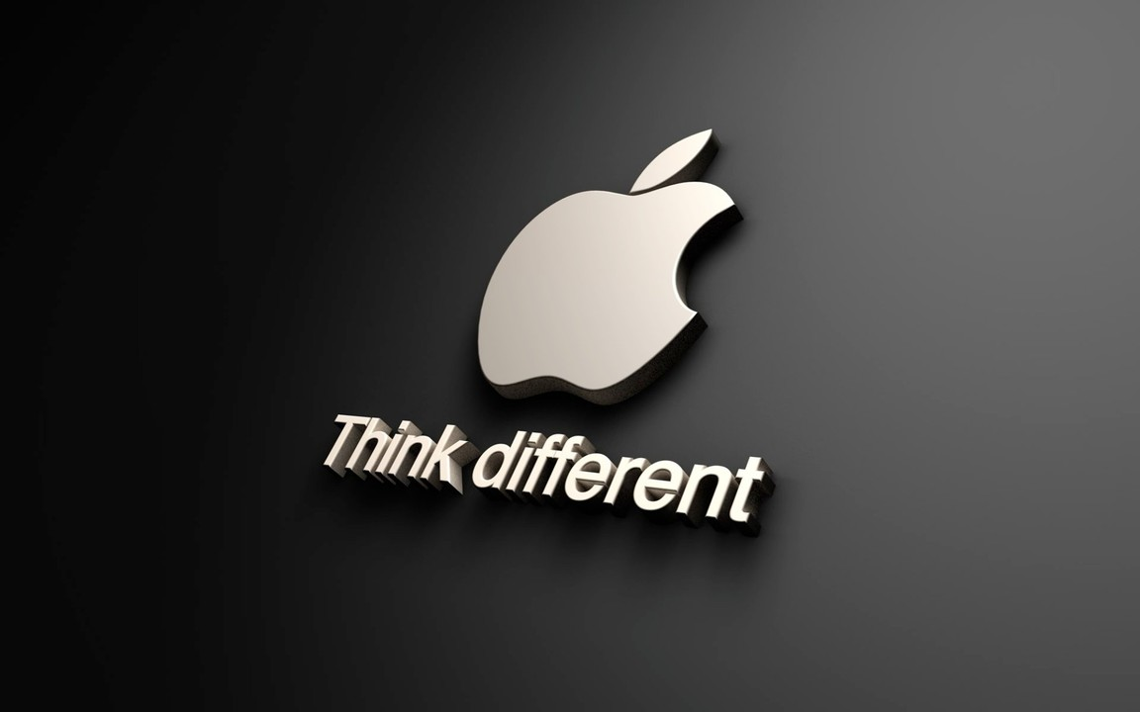
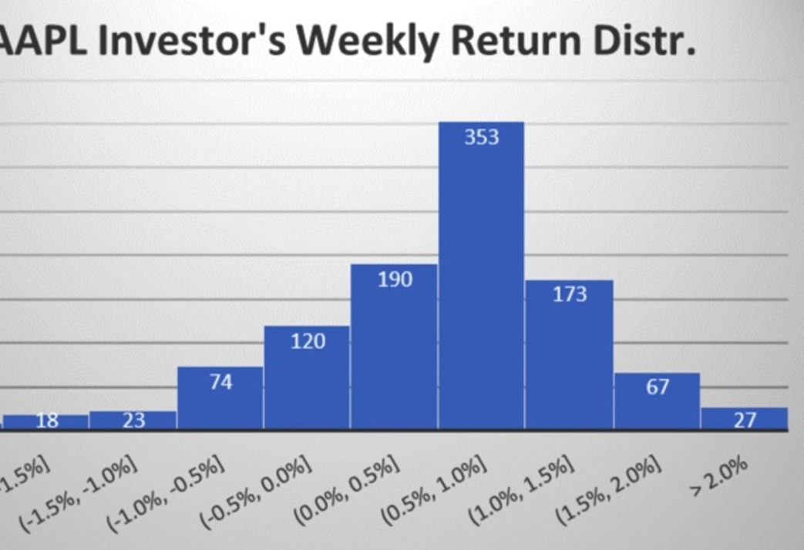
Failing to achieve a return on investment + Cultural Problems H
Notes:
One of the biggest risks connected to innovation and enterprise is not seeing a return on investment. Think of the group conducting research and development on a multi-project. Ears at a substantial price, which is cutting edge and novel at first, but by the time it is improved, tested, and released onto the market, the market may have seen a rival or substitute good or service fulfil the need.
Cultural issues may impede the commercialization of an idea or product. Opposition to change, such as clients who would rather continue using their current provider or staff members who won't adjust to a new procedure: Neither Samsung's 2013 release of a phone with a curved screen nor Microsoft's selection of curved keyboards have been particularly groundbreaking to this point.

Slide 16

Unsupportive systems and processes + Insufficient support from leadership and management Y
Notes:
Unsupportive systems and processes:
Apple's unsupportive systems and processes often stem from its tightly controlled ecosystem, which can be restrictive for both developers and users. The company's stringent App Store policies and high commission fees have faced criticism from society for limiting app developers' flexibility and profitability. Additionally, Apple's emphasis on proprietary technologies, such as the Lightning connector and its closed iOS operating system, can create compatibility issues with non-Apple devices and software. This walled-garden approach, while enhancing security and user experience within the Apple ecosystem, can be seen as unsupportive to broader industry standards and interoperability, often leading to frustrations among users who seek more flexibility and integration with diverse technologies.
Insufficient support from leadership and management:
Apple has occasionally faced criticism for insufficient support from its leadership and management, particularly regarding internal communication and employee relations. Instances of this include allegations of a lack of transparency and responsiveness to employee concerns, such as workplace conditions, diversity and inclusion efforts, and responses to unionization efforts. Some employees have reported feeling undervalued and unheard, which can impact morale and productivity. Additionally, rapid decision-making processes driven by top leadership sometimes result in inadequate consultation with lower-level management, leading to gaps in strategy execution. Despite Apple's strong market performance, these internal challenges highlight areas where leadership could enhance support and foster a more inclusive and communicative organizational culture.

